Slide 1
Geometric Transform and Its Applications
Instructor
LE Thanh Sach, Ph.D.
Ltsach@cse.hcmut.edu.vn

Slide 2
Outline
Geometric Transform
Its Applications

Slide 3
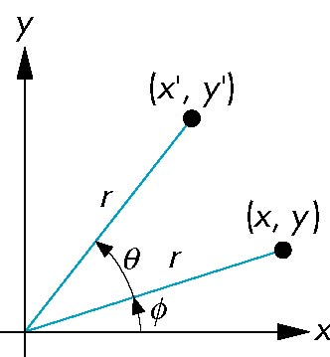
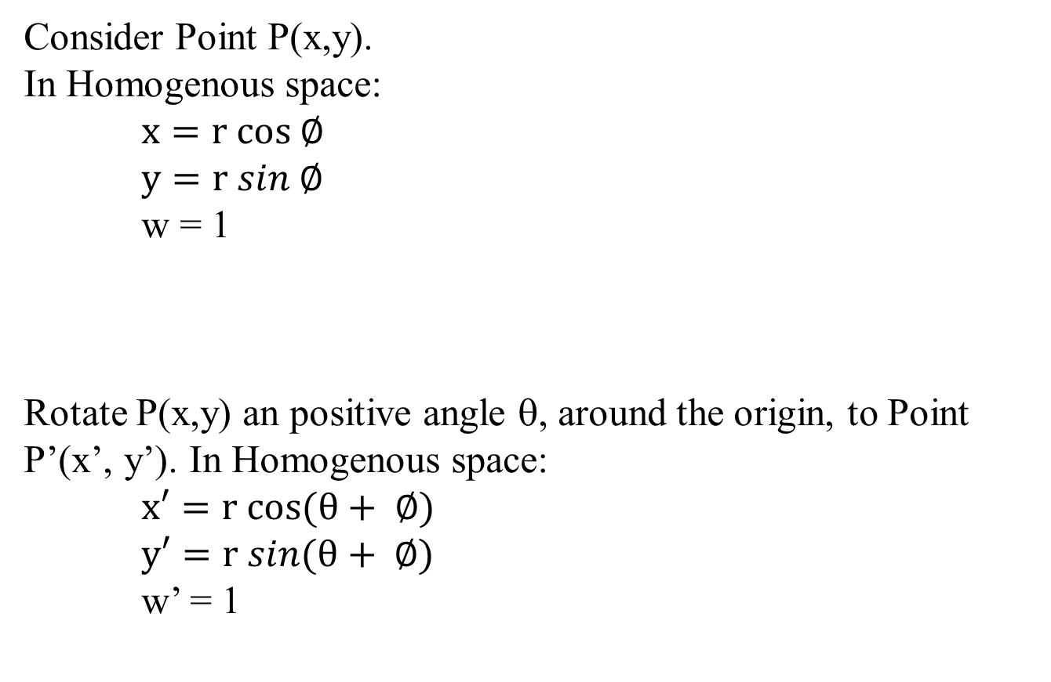
Homogenous system
Rotation Matrix
Consider Point P(x,y).
In Homogenous space:
$x=r cos ∅$
$y=r sin ∅$
w = 1
Rotate P(x,y) an positive angle θ, around the origin, to Point P’(x’, y’). In Homogenous space:
$x′=r cos(θ+ ∅)$
$y′=r sin(θ+ ∅)$
w’ = 1
P’
P

Slide 4
Homogenous system
Rotation Matrix
P’
Point P’(x’,y’):
P

Slide 5
Homogenous system
Rotation Matrix
Known form of the transform matrix:
And, two points P and P’:
The transformation:

Slide 6
Homogenous system
Rotation Matrix
Identity:
Rotation matrix:

Slide 7
Homogenous system
Translation Matrix
Identity:
Translation matrix:

Slide 8
Homogenous system
Scaling Matrix
Identity:
Scaling matrix:

Slide 9
Homogenous system
Shearing
y
P
P’
y’ = y
θ
x
x
x’

Slide 10
Homogenous system
Shearing
Identity:
Shearing (along x-direction) matrix:

Slide 11
Homogenous system
Shearing
y
y’ = y
P’
φ
P
x
x’ = x

Slide 12
Homogenous system
Shearing
Identity:
Shearing (along y-direction) matrix:

Slide 13
Homogenous system
Shearing
Shearing (along x and y-direction) matrix:

Slide 14
Homogenous system
Affine transform
Scaling:
Translation:
Rotation:
Shearing:

Slide 15
Homogenous system
Projective transform

Slide 16
Projective transform
Estimation

Slide 17
Projective transform
Estimation

Slide 18
Projective transform
Estimation
Rearrange terms:
Insert some dummy terms:

Slide 19
Projective transform
Estimation
Matrix Form:
a_{ij}: variables

Slide 20
Projective transform
Estimation
To find the value for 8 variables (a_{ij}), need to formulate at least 8 equations.
i.e., need at least four pairs of mapping points:

Slide 21
Projective transform
Estimation
for N pairs:
2N×8
8×1
2N×1
Pair 1:
Pair 2:
Pair 3:
Pair 4:
Additional pair:

Slide 22
Projective transform
Estimation
Matrix form:
2N×8
8×1
2N×1
8×2N
2N×8
8×1
8×2N
2N×1
8×8
8×1
8×1

Slide 23
Projective transform
Estimation
Solution:
Matlab:

Slide 24
Implementation of a transformation
Implementation
Forward Mapping
Backward Mapping
(Holy effect)
Zero-Order
Interpolation
Bilinear
Interpolation
Cubic
Interpolation

Slide 25
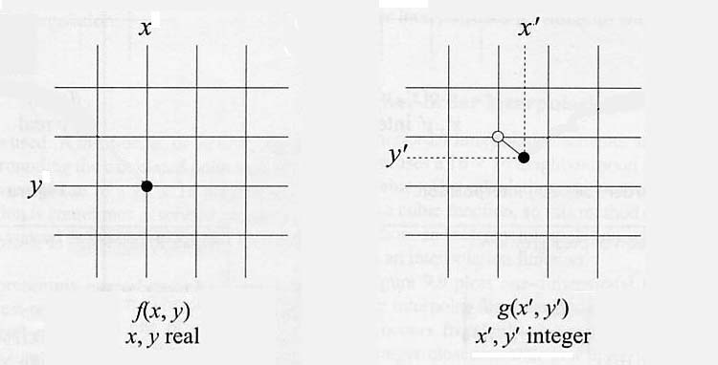
Forward mapping

Slide 26
Forward mapping
For each pixel P
Compute P’= M.P
g(round(x’), round(y’)) = f(x,y)
End for

Slide 27
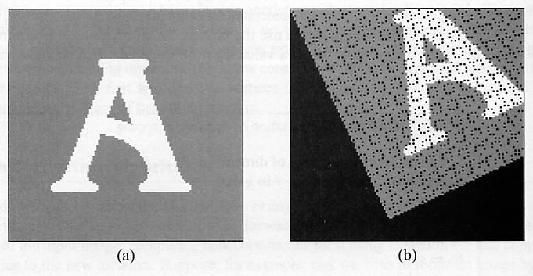
Forward mapping
Example
Rotate f(x,y) an positive angle 25º

Slide 28
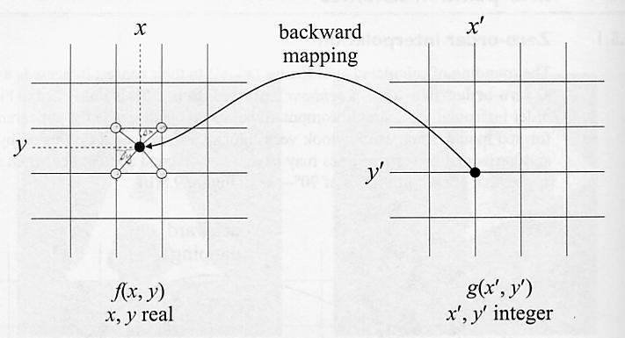
Backward mapping

Slide 29
Backward mapping
For each pixel P’
Compute P= M⁻¹.P’
g(x’, y’) = interpolation[f(x_{o},y_{o})]
End for

Slide 30
Backward mapping
Inverse transform
Scaling:
Translation:
Rotation:
Shearing:

Slide 31
Backward mapping Zero-order interpolation

Slide 32
Backward mapping Bilinear interpolation

Slide 33
Backward mapping Cubic interpolation

Slide 34


Backward mapping Example: zero-order interpolation
Scaling

Slide 35

Backward mapping Example: bilinear interpolation
Scaling

Slide 36
Backward mapping Example: cubic interpolation
Scaling

Slide 37



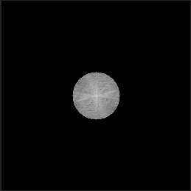
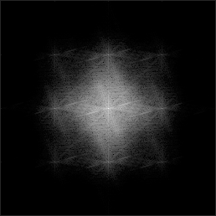
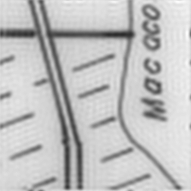

Processing in frequency domain
Original
Up-Sampling
DFT
LPF
IDFT
ILPF
BLPF

Slide 38
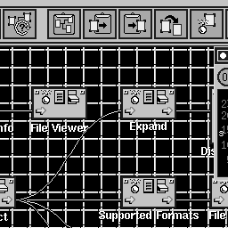

Processing in frequency domain
Sub-sampling
Original
Reduced Image

Slide 39


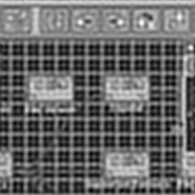

Processing in frequency domain
DFT
ILPF
Original
IDFT
Sub-sampling

Slide 40
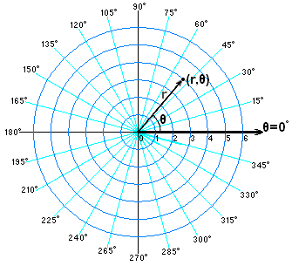
Polar Transform

Slide 41
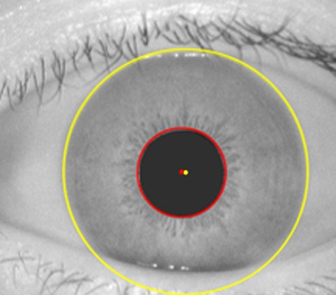
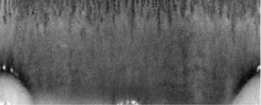
Polar Transform
Example
θ
r

